Slide 1
BITS Pilani presentation
K.Anantharaman
kanantharaman@wilp.bits-pilani.ac.in
11/11/23
SE ZG544 S1-23-24 Agile Software Process

Slide 2
Module 11&12 - Agile Myths and Pitfalls, Ensuring Agile Success
11/11/23
SE ZG544 S1-23-24 Agile Software Process

Slide 3
Agile Myths/Misconceptions
Myth #1) Agile is a Methodology
Agile is a mindset, a philosophy that describes a set of values and principles coined in the Agile Manifesto. Not a step by step process or methodology.
Myth#2) Agile =Scrum
Not true, Kanban, XP, Lean, Crystal …
Myth#4) Agile is Anti Documentation
Not true, Minimum documents needs to product for support and maintenance
Myth#4) Agile Means no planning
Not true. Daily, Iteration, Release
Myth#5 Work must fit into sprint
Not true, Kanban dose not require sprinting
11/11/23
SE ZG544 S1-23-24 Agile Software Process

Slide 4
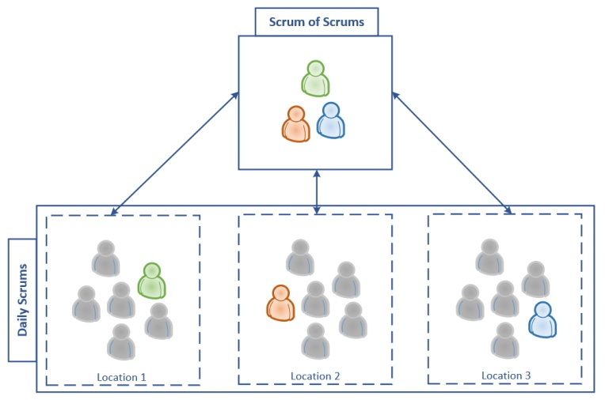
Scaling Scrum: Scrum of Scrums
What work has your team completed since the last Scrum of Scrums?
What work is you team planning to do before the next Scrum of Scrums?
What current or predicted blockers does your team have?
What blockers could you cause another Scrum team?
Source: Product Management Journal Vol.7.
11/11/23
SE ZG544 S1-23-24 Agile Software Process

Slide 5
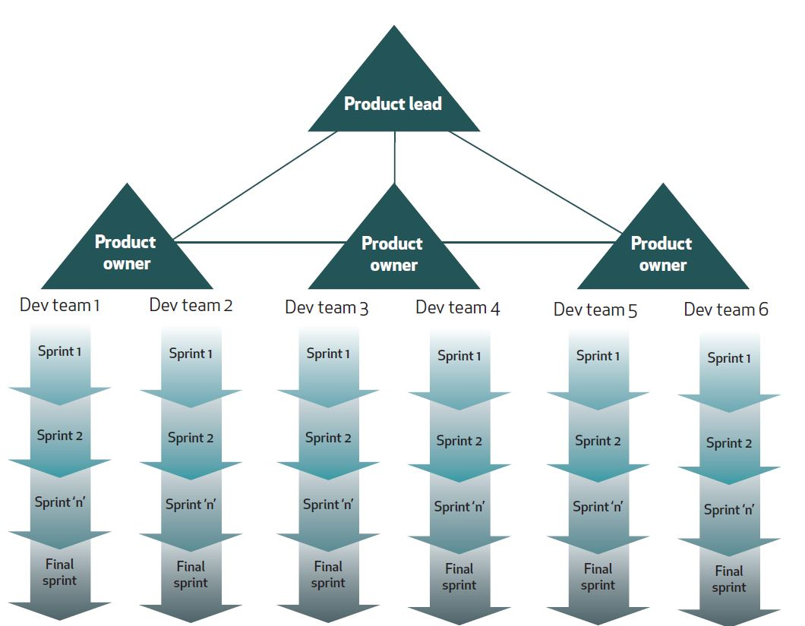
Scaling Scrum/ Scrum of Scrum/ SAFe
Scrum is great for standalone development projects where goals are changing and the scale can be handled by a single team.
Challenges for large projects, multiple teams,
different locations.
Drive hybrid development as shown in the diagram such Scaled Agile Frame work (SAFe).
Source: Product Management Journal Vol.7.
11/11/23
SE ZG544 S1-23-24 Agile Software Process

Slide 6
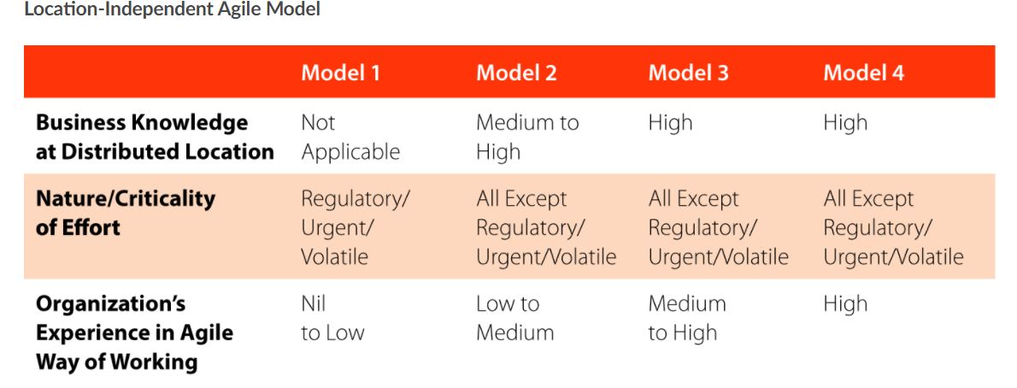
Distributed Agile Models
Minimally
Distributed
Significantly
Distributed
Fully
Distributed
Local
Source: https://www.tcs.com/perspectives/articles/how-to-make-location-independent-agile-work
11/11/23
SE ZG544 S1-23-24 Agile Software Process

Slide 7
Key issues with Distributed Model
Communication
Team Issues & Trust
Release planning & Execution
Lack of visibility
11/11/23
SE ZG544 S1-23-24 Agile Software Process

Slide 8
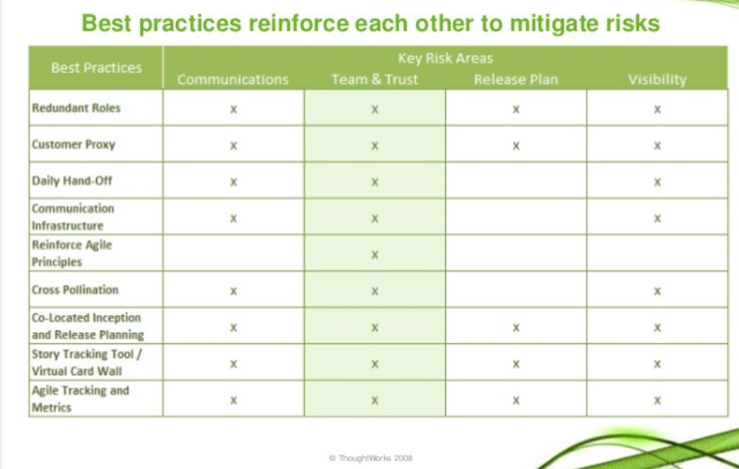
Distributed Agile team best practices
Source: https://www.slideshare.net/ThoughtWorks/simons-rickmeierdistributedagilev3?from_action=save
11/11/23
SE ZG544 S1-23-24 Agile Software Process

Slide 9
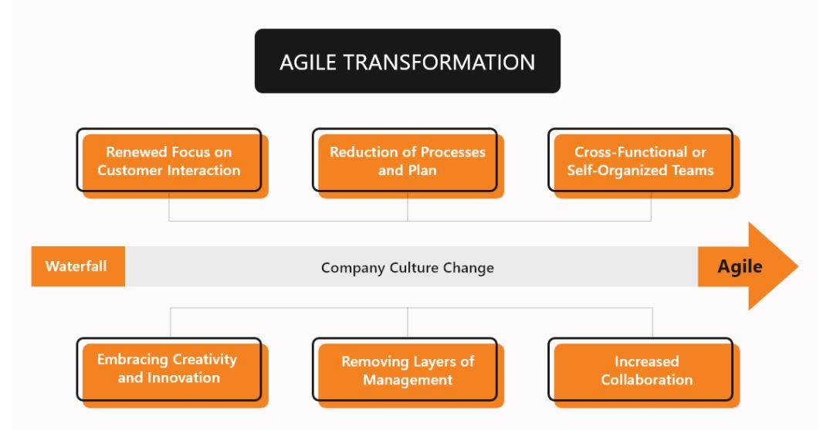
Agile Transformation
Source: https://customerthink.com/how-agile-transformation-is-different-from-digital-transformation/
11/11/23
SE ZG544 S1-23-24 Agile Software Process

Slide 10
Additional Notes
11/11/23
SE ZG544 S1-23-24 Agile Software Process

Slide 11
Distributed Agile/Location Independent Agile teams
Covid-19 sudden disruption and impact
https://www.mckinsey.com/business-functions/organization/our-insights/revisiting-agile-teams-after-an-abrupt-shift-to-remote
TCS Perspectives:
First: Assess the Organization:
What is the level of business expertise and other skills required, and to what extent do they exist at a specific location?
If a location lacks business expertise, it will require more of it to be able to support agile teams there.
How urgent and volatile is the work?
Location-independent agile teams should focus on work that is neither urgent nor volatile. If the work is both, if it has non-negotiable constraints (such as overnight fixes, intra-day scope changes, or regulatory requirements), or if there is a need for constant access to the project owner, it’s best to work with teams in the same location, if at all possible.
Source: https://www.tcs.com/perspectives/articles/how-to-make-location-independent-agile-work
11/11/23
SE ZG544 S1-23-24 Agile Software Process

Slide 12
Distributed Agile/Location Independent Agile teams …
How mature is the organization?
When teams are relatively new to agile approaches, team members should be co-located. Having a common understanding of agile culture, especially among the leadership, indicates the organization can succeed with location-independent teams.
Source: https://www.tcs.com/perspectives/articles/how-to-make-location-independent-agile-work
11/11/23
SE ZG544 S1-23-24 Agile Software Process

Slide 13
Distributed Agile Models
Local - Model-1 ; This model is best when the teams are new to the business area, when continuous access to a product owner is paramount, or when regulatory concerns require the project to be executed in a specific geography.
Minimally Distributed (Model 2):The product owner and a few members of a project or program are located together as one team, while the rest of them work together as another inter-related team in a different place. This model requires the teams to understand the underlying business processes for their product.
Significantly Distributed (Model 3):Team has shared understanding of the business processes of a project or program are well positioned to adopt significantly distributed agile work processes.
Fully Distributed (Model 4):The product owner may be at any site, while the rest of the project or program team members are grouped in agile teams across distributed locations. These teams each include product specialists with sufficient business knowledge to drive day-to- day decisions within a framework defined by the product owner.
Source: https://www.tcs.com/perspectives/articles/how-to-make-location-independent-agile-work
11/11/23
SE ZG544 S1-23-24 Agile Software Process

Slide 14
Agile Transformation
An agile transformation is an act of transforming an entire organization into an elegant and thrive in a collaborative, flexible, self-organizing, and fast-changing environment based on Agile principles.
Agile principles can be taught throughout any organization to develop teams to benefit from the rewards of healthy agility. The organizational mindset should change and embrace a culture of self-organization and collaboration.
Agile transformation allows organizations to be reactive and better serve their clients’ interests with less effort, which requires significant support and resources to stick it out when things get bumpy.
11/11/23
SE ZG544 S1-23-24 Agile Software Process

